Slide 1
Investigation Task
21/02/2024
Year 7 Science

Slide 2
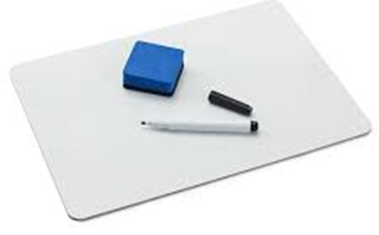
Review: Variables
You change on purpose …
You measure as your result …
Must be kept the same to make it a fair test…
Goes in the first column on a table…
Goes on the x axis on a graph …

Slide 3
Learning Intentions
Collaboratively and individually plan and conduct a range of investigation types, including fieldwork and experiments, ensuring safety and ethical guidelines are followed

Slide 4
Success criteria
Write a title for your table
Complete your predictions table
List materials/equipment required
Write your method, step by step

Slide 5
Variables in tables
Independent Variable (units) eg tire | Dependent variable (units) eg distance (m)

Slide 6
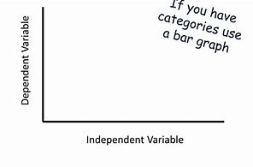
Variables in graphs
(units)
title
(units)

Slide 7
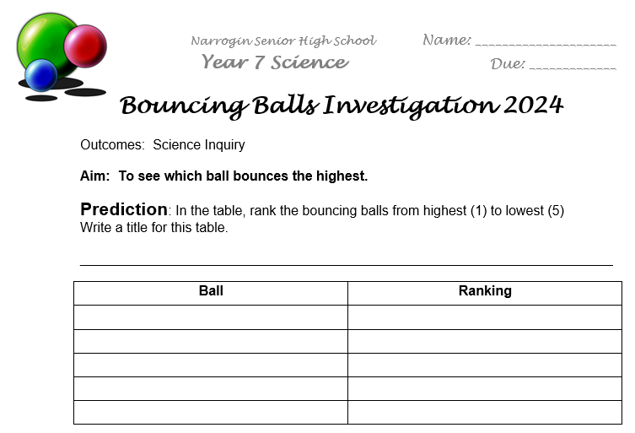

Slide 8
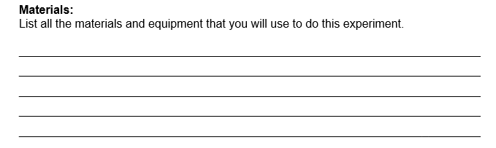

Slide 9
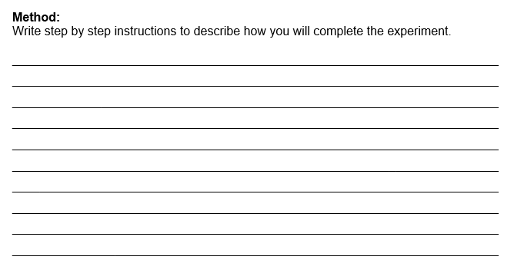

Slide 10
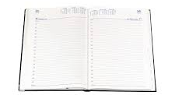
Homework
Homework sheet – Analysing graphs
Due Monday 26 Feb

